Slide 1
Factors that Influence the Occurrence of Stroke -
An Exploratory Analysis
Team 18: Emily Lau, Ente Kang, Yacine Marouf

Slide 2
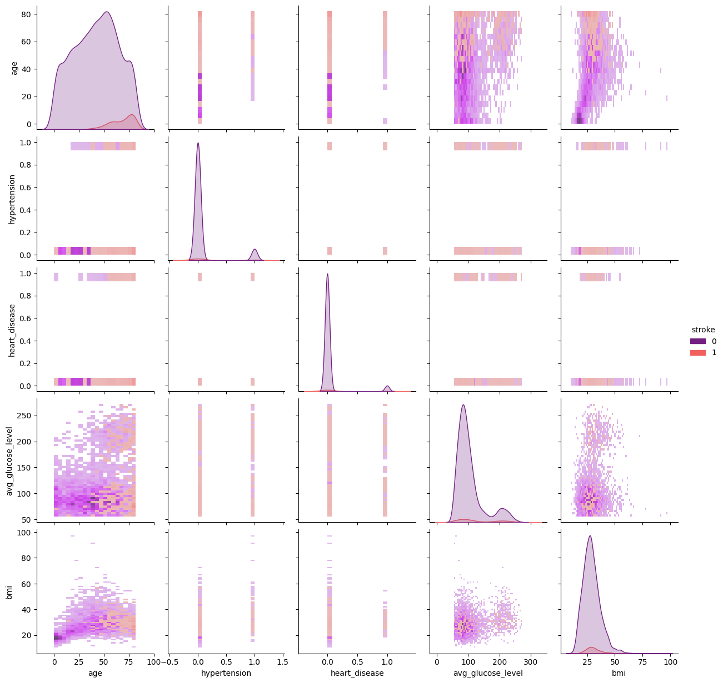
Research Questions & Preprocessing
What are the risk and public health factors associated with the occurrence of strokes?
What is the accuracy of the logistic regression model in predicting strokes
Notes:
Strokes occur when blood clots formed from fat, cholesterol, or other substances clog blood vessels and arteries in the brain and are the second leading cause of death worldwide^{1,2}. Given this problem, our team aims to answer the following research questions using: (1) What risk and public health factors are strongly associated with whether patients experienced a stroke?, and (2) What is the accuracy of the logistic regression model in classifying and predicting the occurrence of strokes?

Slide 3
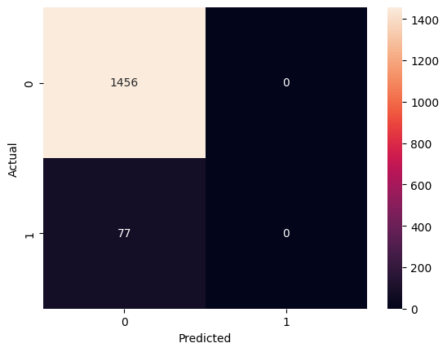
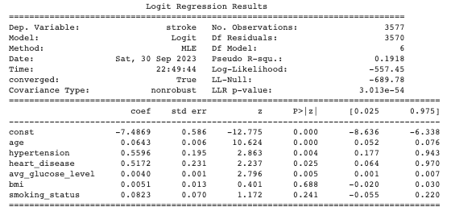
Results & Interpretation
Figure 2: Logistic Regression Fit
Figure 1: Confusion Matrix for Stroke Predictions
Notes:
Confusion matrix:
Summary table (EL):
age feature has a coefficient of 0.06 with a p-value of 0.000, suggesting that for every one unit increase in age, the odds of stroke increases by approximately 6.2%, while assuming all other variables are held constant
Avg_glucose_level has a coefficient of 0.004 and a p-value of 0.001, illustrating that for every one unit increase in average glucose levels, the odds of stroke increased by 0.4% while assuming all other variables are held constant.
For bmi, it has a coefficient of 0.0051 and a p-value of 0.688. This suggests that for every one unit increase in BMI, the odds of stroke will increase by 0.5% if all other variables are held constant. The caveat is that the p-value is greater than 0.5, suggesting this is not a significant result.
Despite the features hypertension, heart_disease, and smoking_status do have coefficients and p-values in the summary report, the interpretation of such values is meaningless as such features are binary variables.

Slide 4
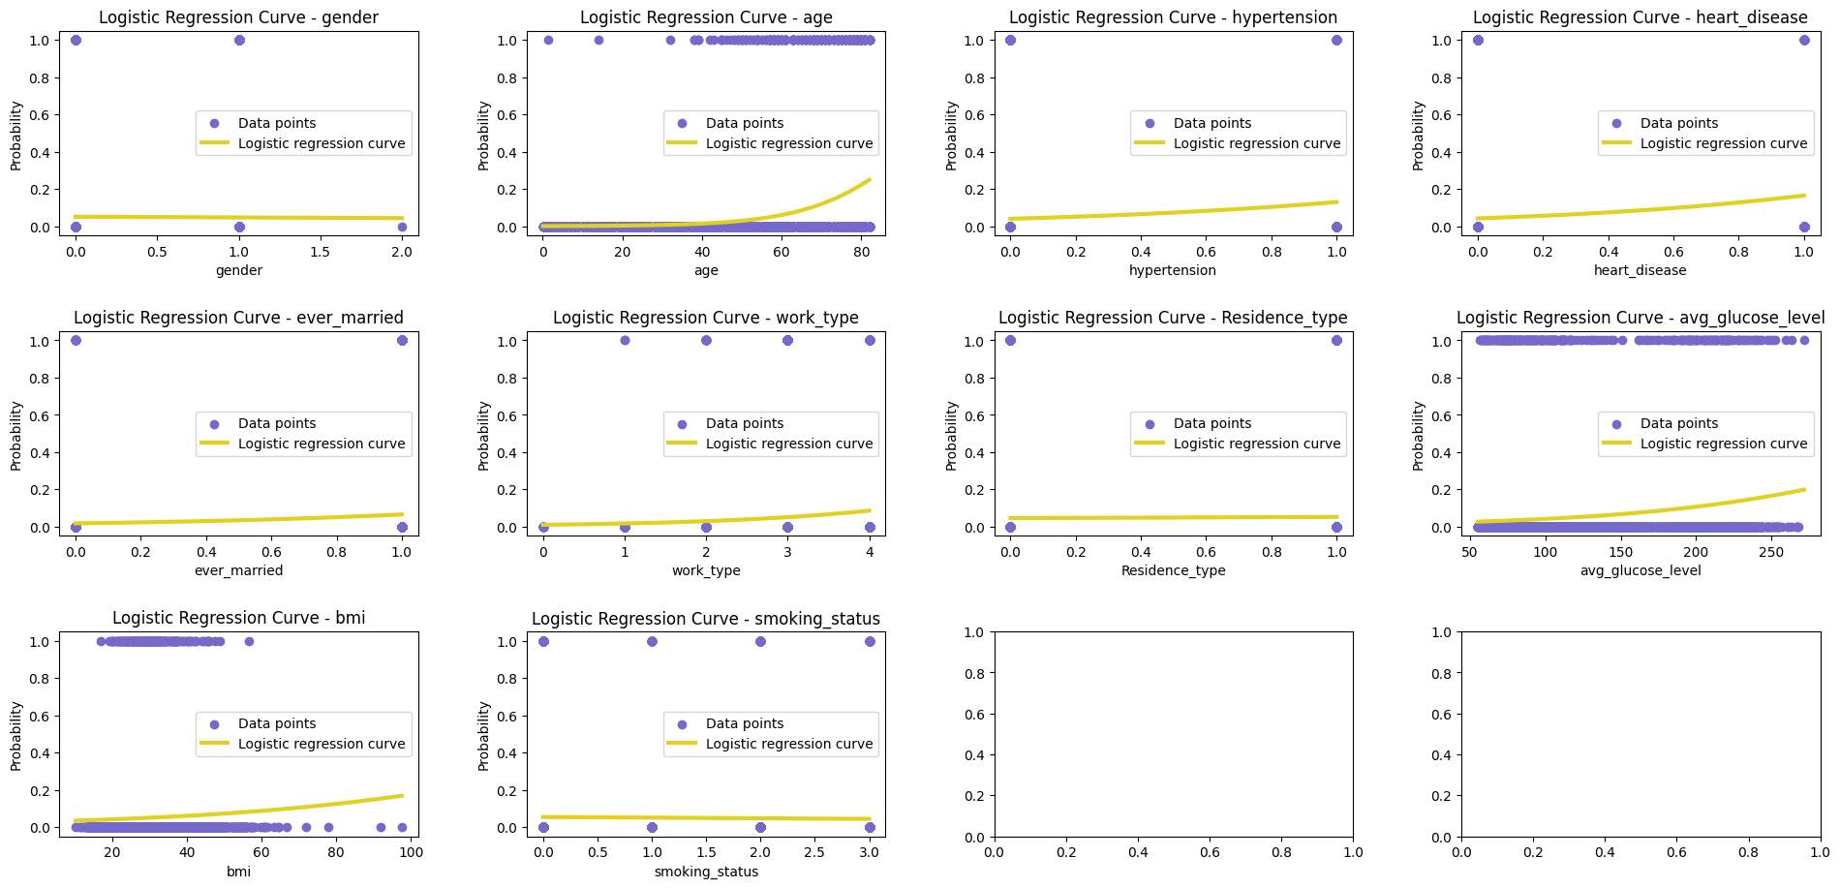
Limitations, Further Analysis, Conclusion
Notes:
The exploratory plots (EL):
We attempted to conduct further exploration on the dataset by running individual logistic regressions for each factor on stroke as the outcome; however, the results were inconclusive.
Conclusion:

